Slide 1
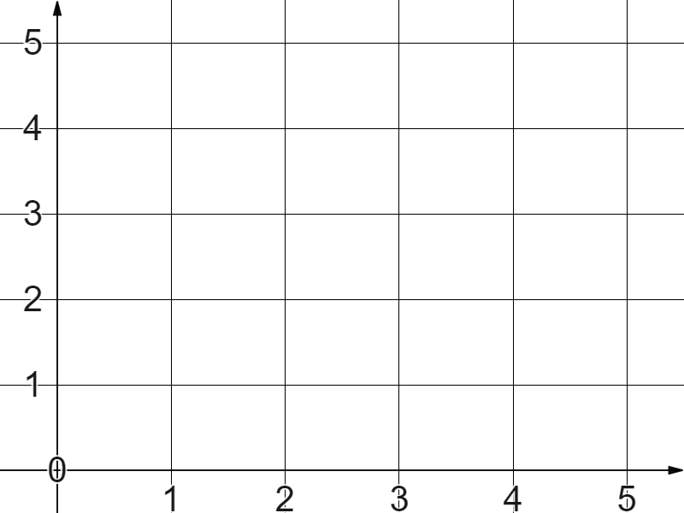
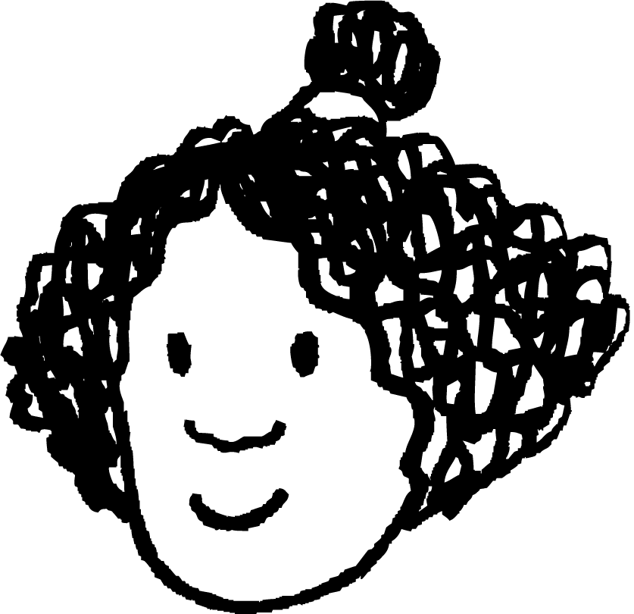
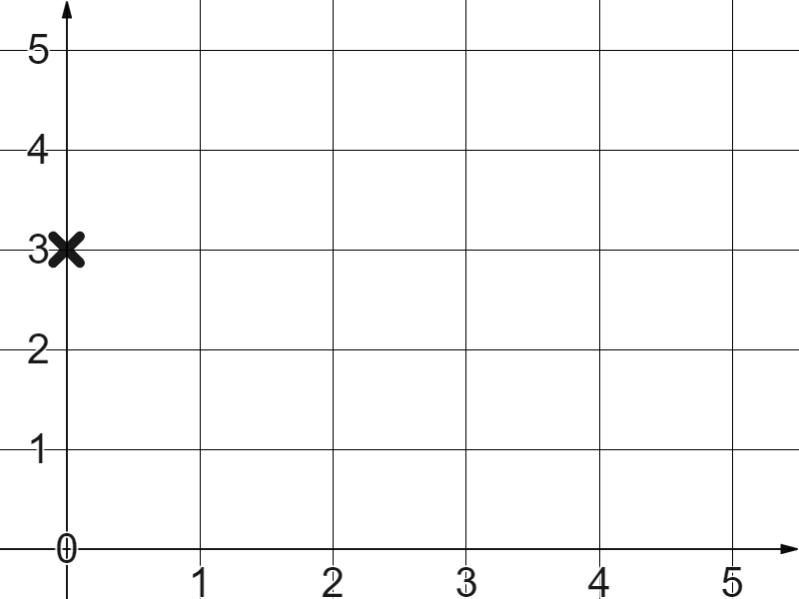
Checking understanding of plotting coordinates
Task A: Plotting coordinates in the first quadrant
1) The coordinate (0,0) where the and axes cross is called the .
2) Plot these coordinates and label them:
(3,5)
(5,3)
(5,5)
(0,5)
3) Izzy plots the coordinate (3,0).
Write a sentence to explain her error.

Slide 2
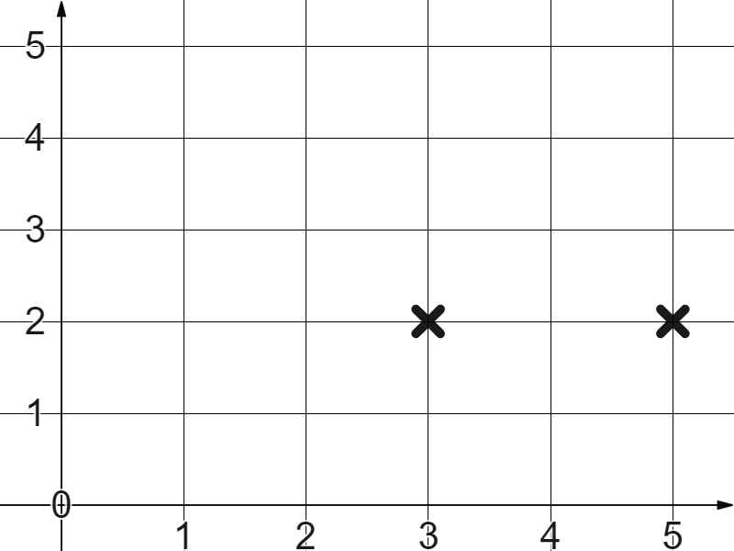
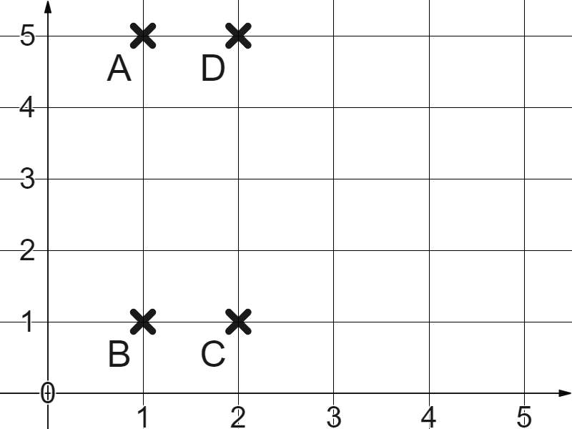
Checking understanding of plotting coordinates
Task B: Using coordinates to plot shapes
1) The first two coordinates are (3,2) and (5,2)
Which other coordinate pairs would form a square?
Task C: Translating shapes
1) Why will the below not create a translation of rectangle ABCD?
A (1,5)
B (1,1)
C (2,1)
D(2,5)
(4,5)
(3,1)
(5,1)
(5,5)
Mathematics in Education and Industry.
v2.1

